Slide 1
Fundamentals - 1
Data Types
Variables
Constants
Rajasekaran S
Assistant Professor,
Department of Information Technology,
KGiSL Institute of Technology,
email: proffraja@gmail.com
Github:www.github.com/rajasekaranap

Slide 2
Data Types Supported By Java
Data Type
Integer
Float
Character
Boolean
int
float
short
double
long
char
boolean
byte

Slide 3
Integer
Type | Storage Required | Range
byte | 1 byte | -128 to 127
short | 2 bytes | -32768 to 32767
int | 4 bytes | -2147483648 to 2147483647
long | 8 bytes | -9223372036854775808 to 9223372036854775807
http://bit.ly/2m0IoFz

Slide 4
Decimal
Type | Storage Required | Range
float | 8 byte | approximately ±3.40282347E+38F (6-7 significant decimal digits)
double | 16 bytes | approximately ±1.797693134862315 0E+308 (15 significant decimal digits)
http://bit.ly/2KJUIZF

Slide 5
Character
Type | Storage Required | Range
char | 2 bytes | 0 to 65,536 (unsigned)
Boolean
Type | Storage Required | Range
bool | - | true or false

Slide 6
Escape Sequence
Escape Sequence | Name
\n | New Line
\b | Backspace
\t | Tab
\r | Carriage Return
\” | Double Quote
\’ | Single Quote
\\ | Backslash

Slide 7
Variables in Java
Variables are data holders in the programming language.
A block of memory is named and accessed using variable name.
The values of the variable may change during program execution.
All variables are statically typed.
You can’t use the variable which is not declared.

Slide 8
Syntax to Declare Variable
datatype variable_name = value
int a = 10;
Single Step
int a;
a=10;
Multi Step

Slide 9
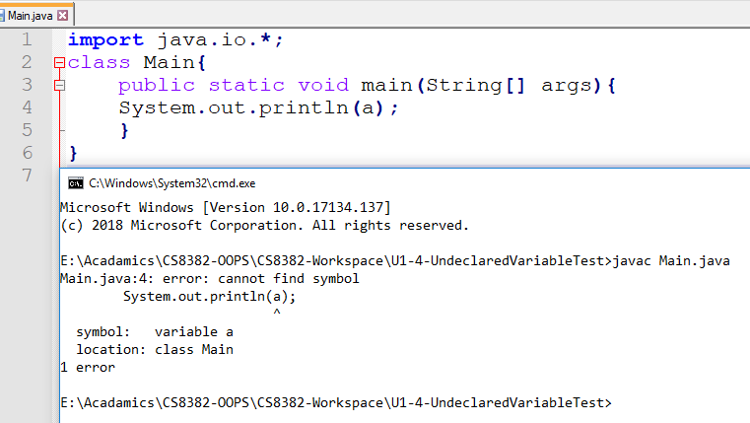
Demo of Undeclared Variable Usage

Slide 10
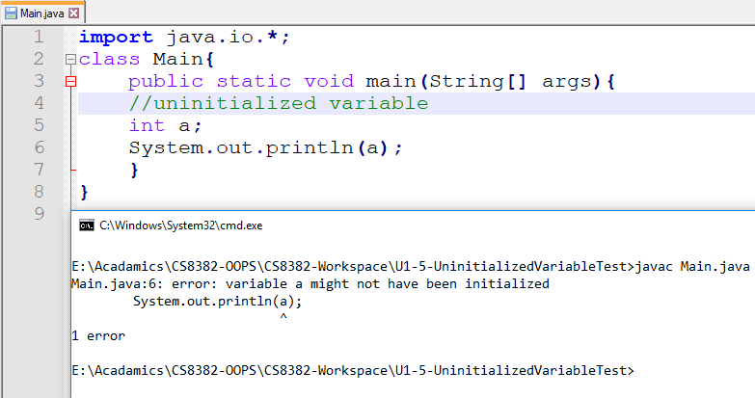
Demo of Uninitialized Variable Usage

Slide 11
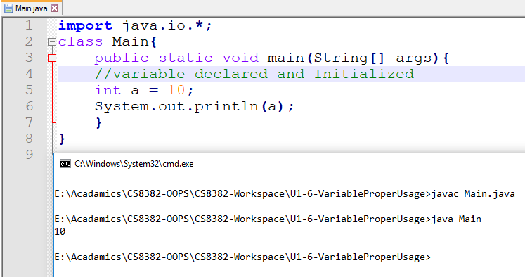
Demo of Proper use of Variable

Slide 12
Constants
Constants are unchangeable variable.
It can be assigned only once.
Then further modification of the value is not allowed.
When ever you need a variable that hold constants for operation can be created as constant variable.
It is declared with final keyword.
Demo
https://youtu.be/AXSnWYz8mEk

Slide 13
Syntax to Declare Final Variable
final datatype variable_name = value
final int a = 10
Recommended
final int a;
a=10
Accepted

Slide 14
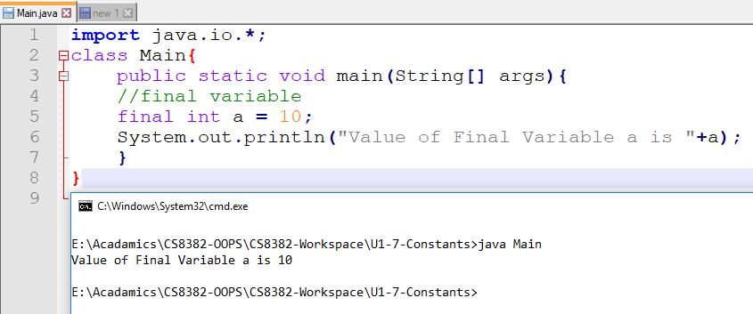
Demo of Final Variable

Slide 15
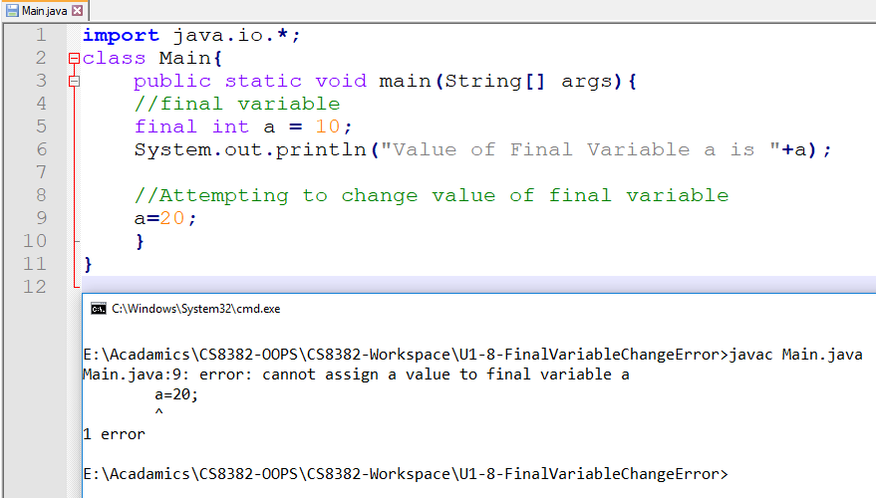
Trying to change final value

Slide 16
Thank You
Rajasekaran S
Assistant Professor,
Department of Information Technology,
KGiSL Institute of Technology,
email: proffraja@gmail.com
Github:www.github.com/rajasekaranap

